Slide 1
Module 4: Interfaces

Slide 2
Interfaces
The interface in Java is a mechanism to achieve abstraction and multiple inheritance in Java..
Like a class, an interface can have methods and variables, but the methods declared in an interface are by default, abstract.
There can be only abstract methods in the Java interface, not method body.

Slide 3
Interfaces
Interface does not have a constructor.
Interfaces are used to implement abstraction. So the question arises why use interfaces when we have abstract classes?
The reason is, abstract classes may contain non-final variables, whereas variables in the interface are final, public and static.

Slide 4
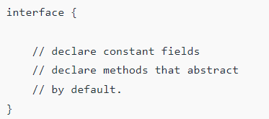
Syntax
To declare an interface, use the interface keyword.
That means all the methods in an interface are declared with an empty body and are public, and all fields are public, static, and final by default.
A class that implements an interface must implement all the methods declared in the interface.
To implement the interface, use implements keyword.

Slide 5
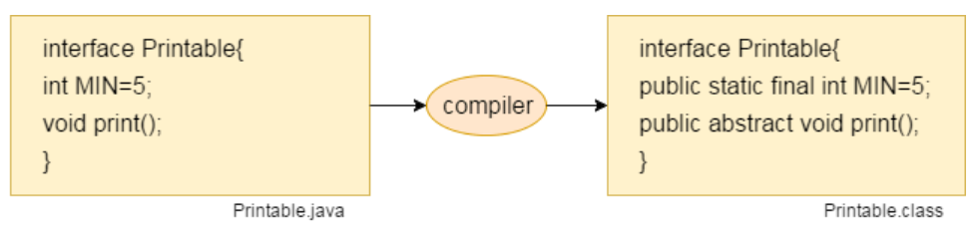
Interface fields are public, static and final by default, and the methods are public and abstract.

Slide 6
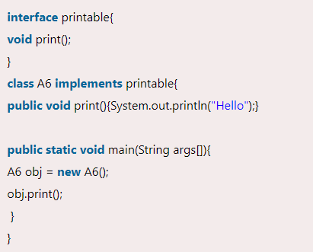
Example 1:

Slide 7
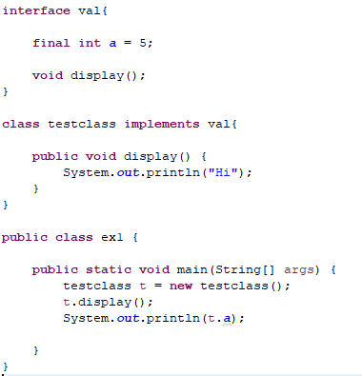

Example 2:

Slide 8
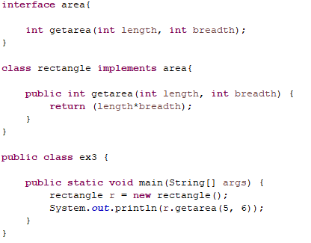
Example 3:

Slide 9
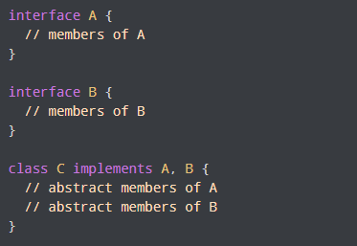
Implementing Multiple Interfaces

Slide 10
Difference between Class and Interface
S. No. | Class | Interface
1 | In class, you can instantiate variables and create an object. | In an interface, you can’t instantiate variables and create an object.
2 | The access specifiers used with classes are private, protected, and public. | In Interface only one specifier is used- Public.

Slide 11
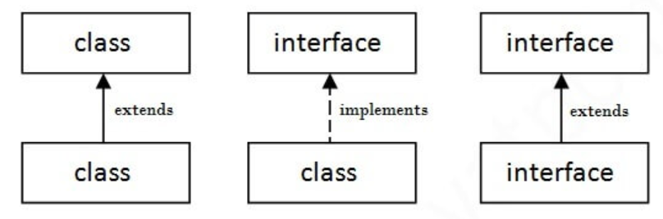
The Relationship between classes and interfaces
a class extends another class, an interface extends another interface, but a class implements an interface.

Slide 12
TRY IT
Write a Java program that demonstrates the use of interfaces and classes to calculate the rate of interest for different banks. The program defines an interface named 'Bank' with a method 'rateOfInterest' and two classes 'SBI' and 'PNB' that implement this interface.
In the 'SBI' class, the 'rateOfInterest' method is implemented to return a fixed interest rate of 9.15%.
In the 'PNB' class, the 'rateOfInterest' method is implemented to return a fixed interest rate of 9.7%.
Write a Java program that:
Creates an object 'b' of type 'Bank' and initializes it with an instance of the 'SBI' class.
Calls the 'rateOfInterest' method on the 'b' object.
Prints the result as "ROI: " followed by the interest rate returned by the 'rateOfInterest' method.

